Slide 1
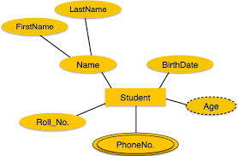

Vendors and Products Data Management

Slide 2
Introduction

Slide 3

A group of vendors popularly known as “PUSHPA SYNDICATE”
These Vendors sell Laptops , Smartphones, TV’s and other electronic items.
They wanted to store,track all their sellings and calculate profits
Vendors approached our company “PaNiSa” for their database management system.
Hyderabad

Slide 4
Problem Definition

Slide 5
Signing Up of the new vendors and storing their information in the database.
Listing all the products they sell in the database
Also, recording each transaction in our database for future reference and to draw statistics.
Adding new product to the database.
Retrieving all the orders on a certain date.

Slide 6
Scope and Perspective of Project

Slide 7
We are only concerned with Vendors and their products.
Sees it with the perspective of only one vendor when logged in.

Slide 8
Logical Model

Slide 9
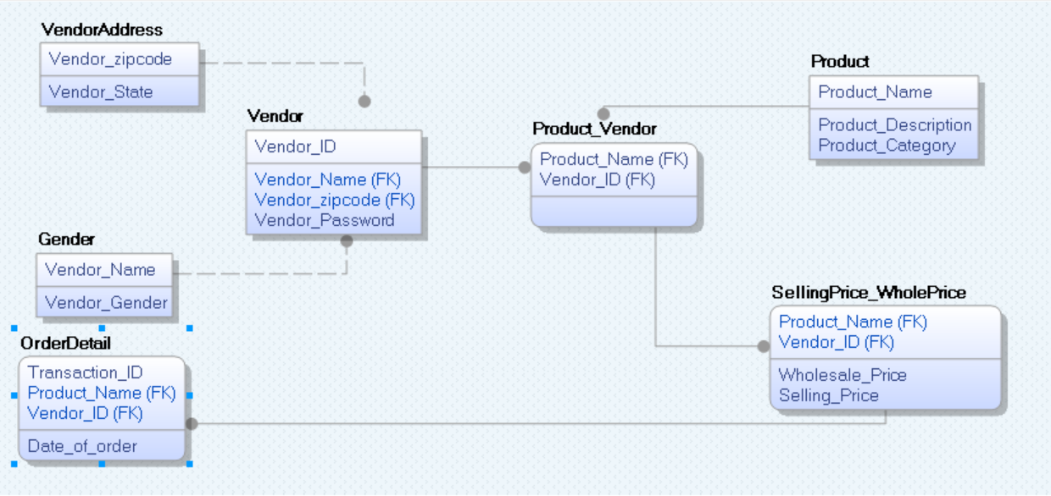

Slide 10
Functional Dependencies

Slide 11
Vendor_ID -> Vendor_Name
Vendor_ID -> Vendor_Zipcode
Vendor_ID -> Vendor_Password
Vendor_Zipcode -> Vendor_State
Vendor_Name-> Vendor_Gender
Product_Name -> Product_Description
Product_Name -> Product_Category
Transaction_ID-> Date
Transaction_ID -> Selling_Price
Transaction_ID -> Wholesale_Price
Product_Name -> Wholesale_Price
Vendor_ID ->Selling_Price

Slide 12
Front End
Angular

Slide 13
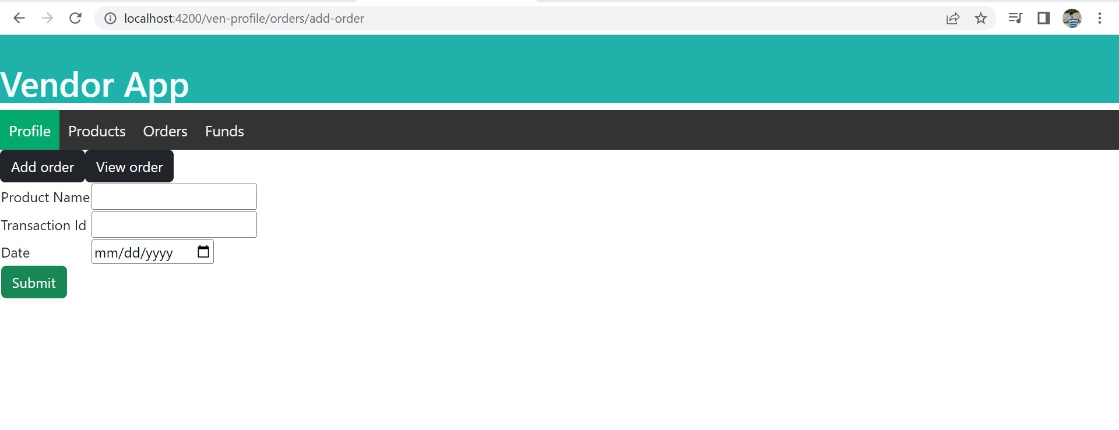
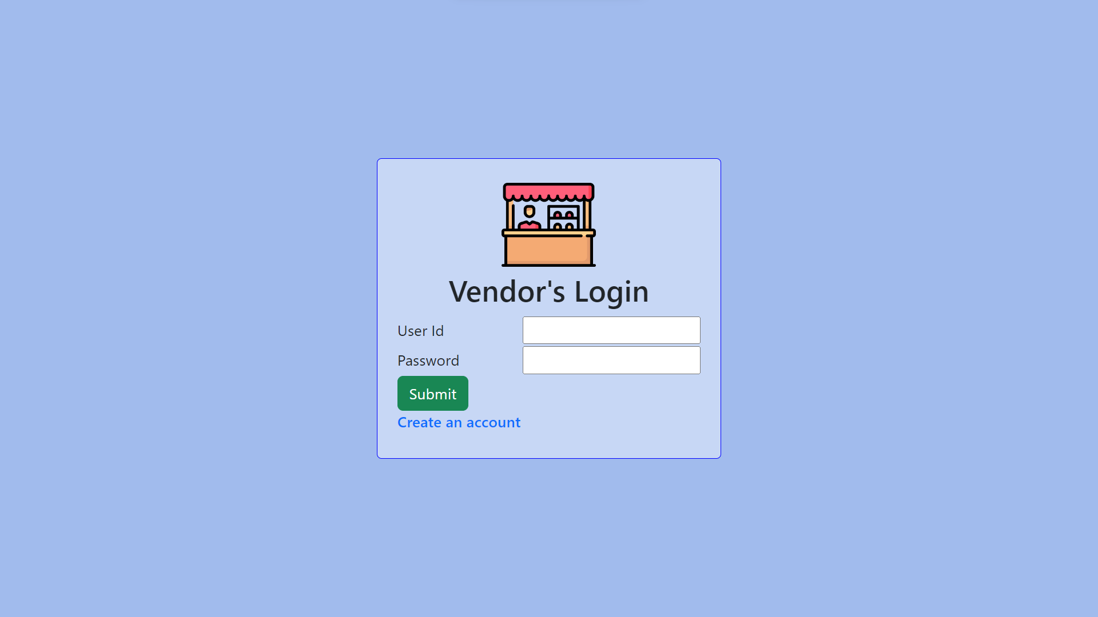
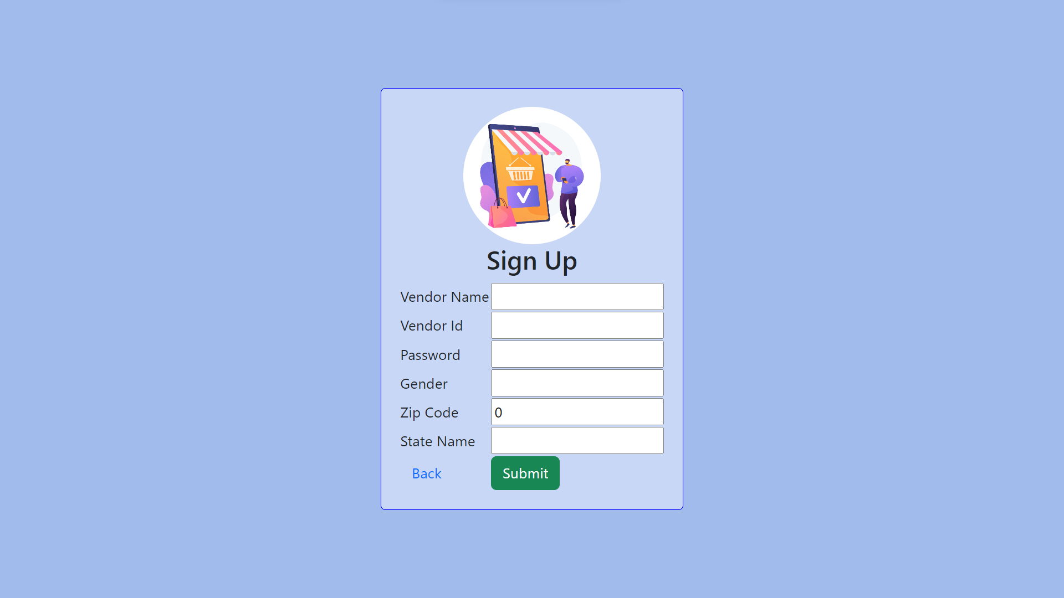
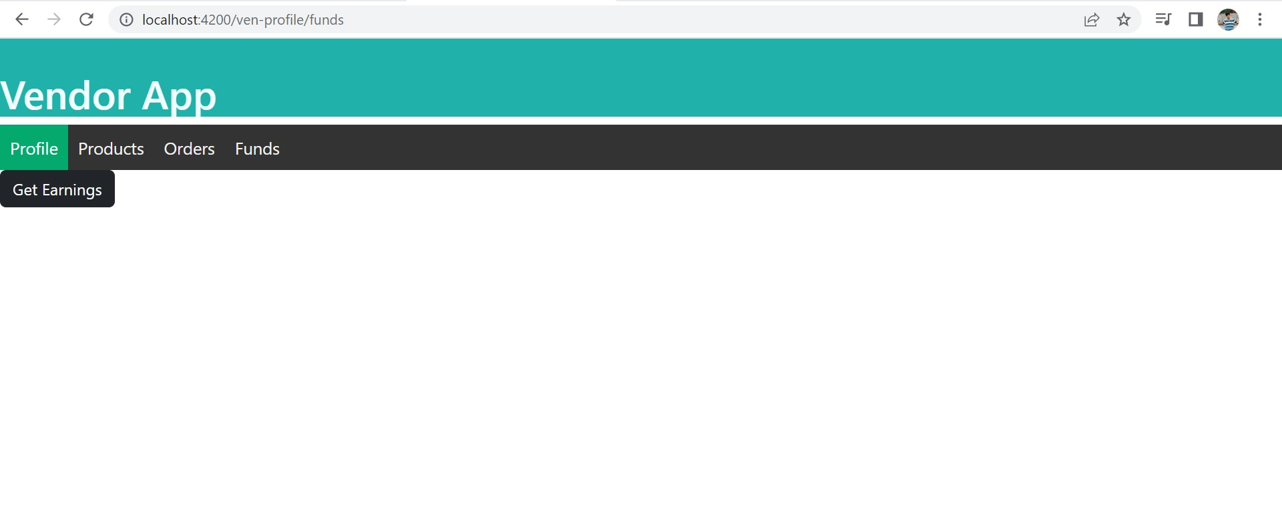
BootStrap 5

Slide 14
Functionalities or use cases
Create a new account and add those details to cloud Database.
Get product details for a vendor given , product name.
Add new products to the inventory for the vendor.
Add new orders and their details to the database.
Fetch order details for a given specific date .
Calculate the profits earned , for a given date, for the vendor.
View Details of the vendor profile.

Slide 15
Angular Features Used
Angular Routing
Angular Reactive Forms
Angular form groups
Angular components and children components

Slide 17
Back-end
ExpressJS

Slide 18
Used Microsoft Azure SQL for creating Database and tables.
Packages Used
Express
Body_parser
Cors
HttpClient
HttpBackend

Slide 19


Slide 20
Cloud

Slide 21
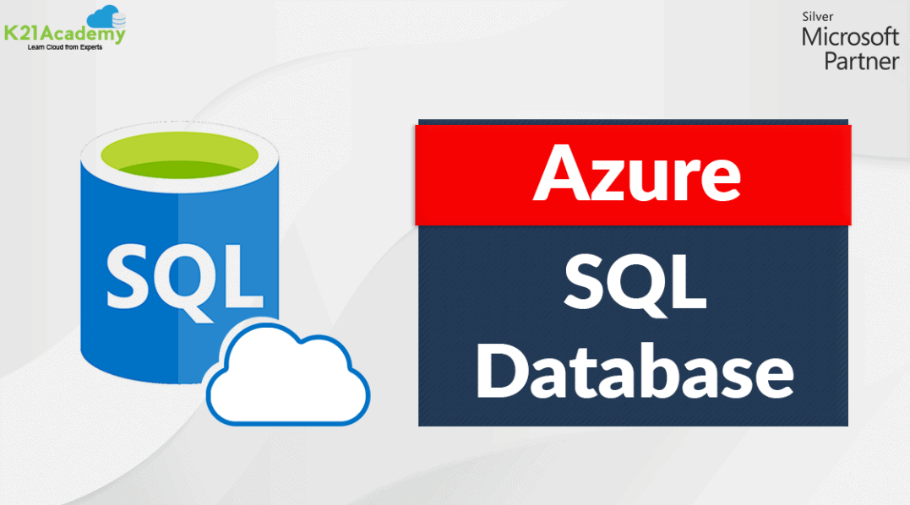

Slide 22
Conclusion

Slide 23
Creating these kind of platforms helps in easy Tax-Filing, drawing statistics, data storing.
Payroll management(Profit distribution based on sales) to the vendors.
Can see all the orders.
We can extend the functionalities to this management tool like customer support, inventory management and many more.

